Slide 1
RUN LENGTH CODEBOOK BASED COMPRESSION
Presented by-
Samagra Agrawal (17uec105)
Samkit Jain (17uec106)
Sankalp Koolwal (17uec108)
Saransh Bankiwal (17uec109)

Slide 2
Problem Definition
Run-length encoding (RLE) is a very simple form of lossless data compression in which runs of data (that is, sequences in which the same data value occurs in many consecutive data elements) are stored as a single data value and count, rather than as the original run. This is most useful on data that contains many such runs.
Certain data sets contain sequences of recurring; identical symbols. These repetitions will be replaced by declaring the length of the sequence.
In image compression, the program takes any image, converts it to binary, and performs RLE on the binary image.

Slide 3
Advantages
This algorithm is very easy to implement and does not require much CPU horsepower. RLE compression is only efficient with files that contain lots of repetitive data. These can be text files if they contain lots of spaces for indenting but line-art images that contain large white or black areas are far more suitable. Computer-generated color images (e.g. architectural drawings) can also give fair compression ratios.
Where is RLE compression used?
RLE compression can be used in the following file formats:
TIFF files
PDF files

Slide 4
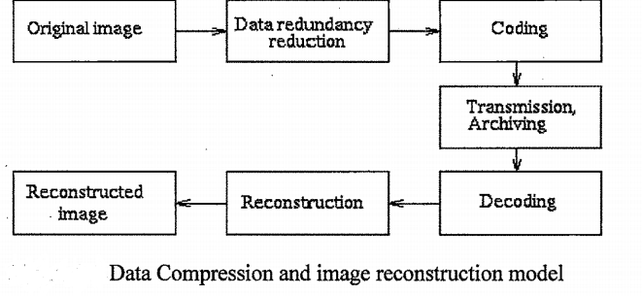
Block diagram of image compression

Slide 5
WORKING
RLE is probably the easiest compression algorithm there is. It replaces sequences of the same data values within a file by a count number and a single value. Suppose the following string of data (17 bytes) has to be compressed:
ABBBBBBBBBCDEEEEF
Using RLE compression, the compressed file takes up 10 bytes and could look like this:
A *8B C D *4E F
As you can see, repetitive strings of data are replaced by a control character (*) followed by the number of repeated characters and the repetitive character itself. The control character is not fixed, it can differ from implementation to implementation.

Slide 6
User defined rle function
function [d,c]=my_RLE(x)
ind=1;
d(ind)=x(1); Ex : 11101100
c(ind)=1;
for i=1:length(x)-1
if(x(i)==x(i+1))
c(ind)=c(ind)+1;
else
ind=ind+1;
d(ind)=x(i+1);
c(ind)=1;
end
end
end
Data | 1 | 0 | 1 | 0
Count | 3 | 1 | 2 | 2

Slide 7
Image Compression Code-
clc;
close all;
clear all;
x = imread('cameraman.tif');
imshow(x);
title('original image');
a = x';

Slide 8
.
a=a(:); %reshapes all elements of a into a single column vector
a=a';
a=double(a);
[data,cb] = my_RLE(a);
y = dec(data,cb);
y1 = reshape(y,[256,256]);
y1 = y1';
y1 = uint8(y1); %Convert a double precision variable to an 8- bit unsigned integer
figure;
imshow(y1);
title(‘reconstructed image’);
c_ratio = length(data)/length(a); % for cameraman.tif compression ratio is 0.84

Slide 9
Decoding of RLE
For Image DeCompression-
function [x] = dec(d,c) Ex : 11101100
x = [];
for i=1:length(d)
x = [x d(i)*ones(1,c(i))];
end 1. x =[111];
end 2. x = [1110]; 3. x = [111011];
4. x = [11101100];
Data | 1 | 0 | 1 | 0
Count | 3 | 1 | 2 | 2

Slide 10
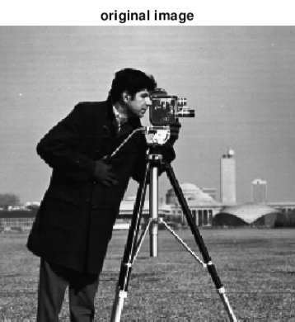
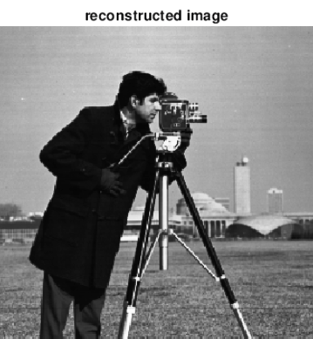
Result

Slide 11
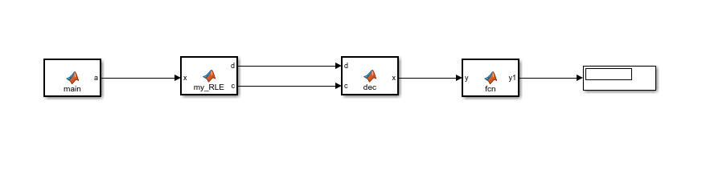
Simulation Block Diagram

Slide 12
C CODE IMPLEMENTATION
#include <iostream>
#include <bits/stdc++.h>
using namespace std;
int main()
{
int n,i,j;
int a[2][2]={{1,1},{0,0}},b[4],f[2][2];
n=4;
int k=0,ind=0,c[n],d[n],e[n]; c[ind]=1;
d[ind]=b[ind];
for(i=0;i<n/2;i++)
{
for(j=0;j<n/2;j++)
{
b[k]=a[i][j];
k++;
}
}
/RLE CONVERSION/ for(i=0;i<3;i++)
{
if(b[i]==b[i+1])
{ c[ind]++;
}

Slide 13
.
else
{
ind++;
d[ind]=b[i];
c[ind]=1;
}
}
/DECODING/
k=0;
for(i=0;i<=ind;i++)
{
while(c[i])
{
e[k]=d[i];
k++;
c[i]--;
}
}
/RECONSTRUCTED IMAGE/
k=3;
for(i=0;i<n/2;i++)
{
for(j=0;j<n/2;j++)
{
f[i][j]=e[k];
k--;
}
}
for(i=0;i<n/2;i++)
{
for(j=0;j<n/2;j++)
{
cout<<f[i][j]
}
cout<<endl;
}
}

Slide 14
Conclusion
Run Length Encoding can be used to encode any type of data losslessly but its beneficial with only a specific type of data which involves a fair amount of redundancy, in some other cases it can even be expensive to use and could cost more bytes than the original data.
In this project we have worked on image compression using run length based codebook compression. We are able to get back our original image with significant compression ratio.

